Slide 2
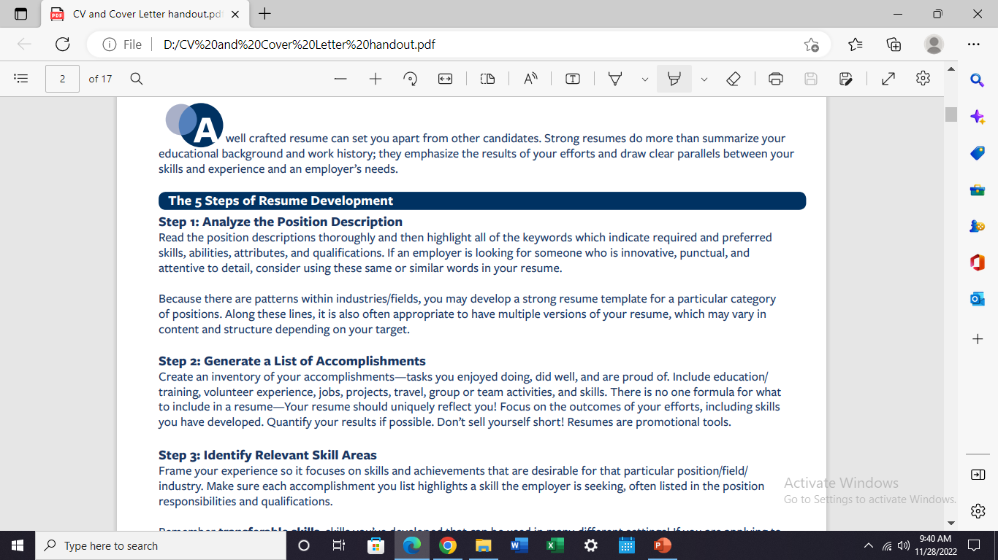

Slide 3
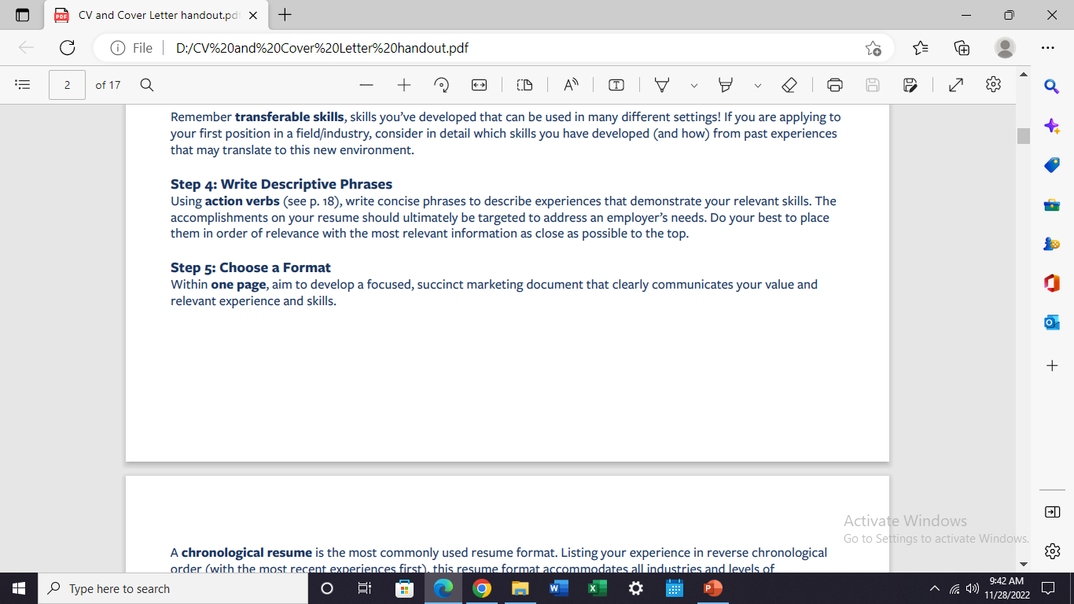
https://www.themuse.com/advice/185-powerful-verbs-that-will-make-your-resume-awesome#:~:text=Action%20verbs%20convey%20doing%E2%80%94for,%E2%80%9D%20or%20%E2%80%9Cexecuted%E2%80%9D%20it.

Slide 4
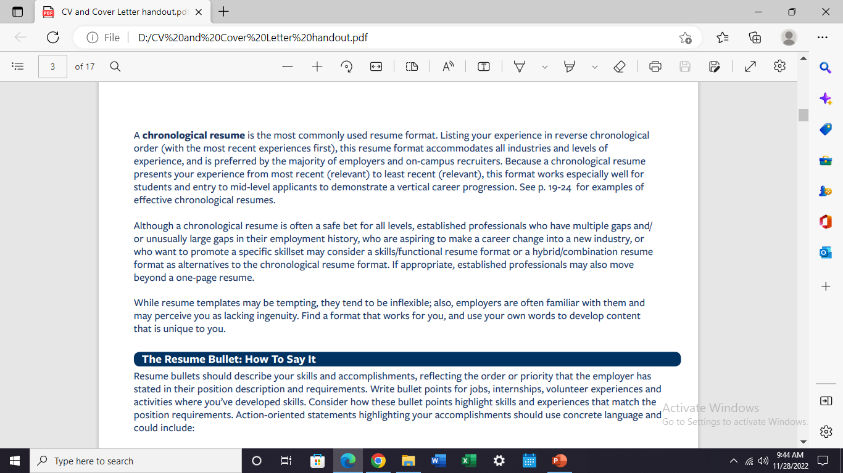

Slide 5
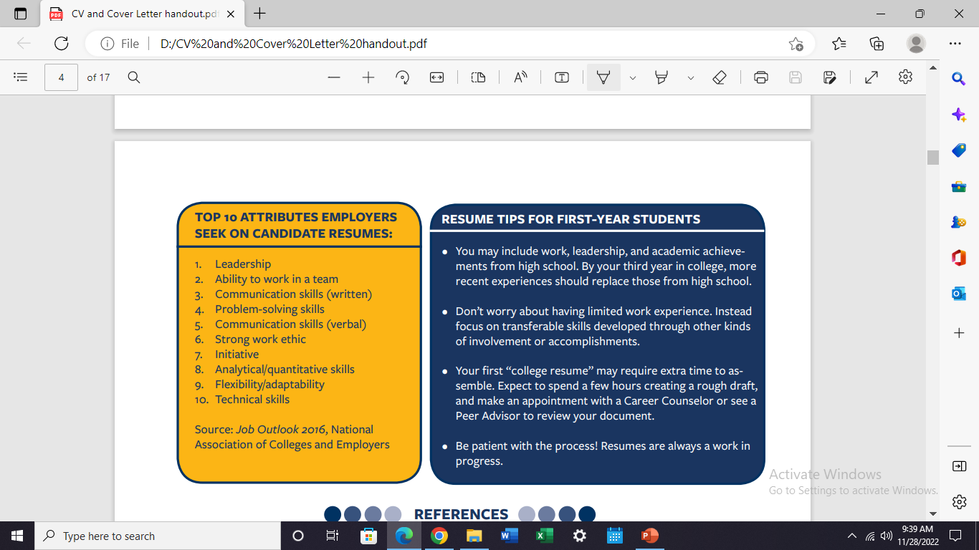

Slide 6
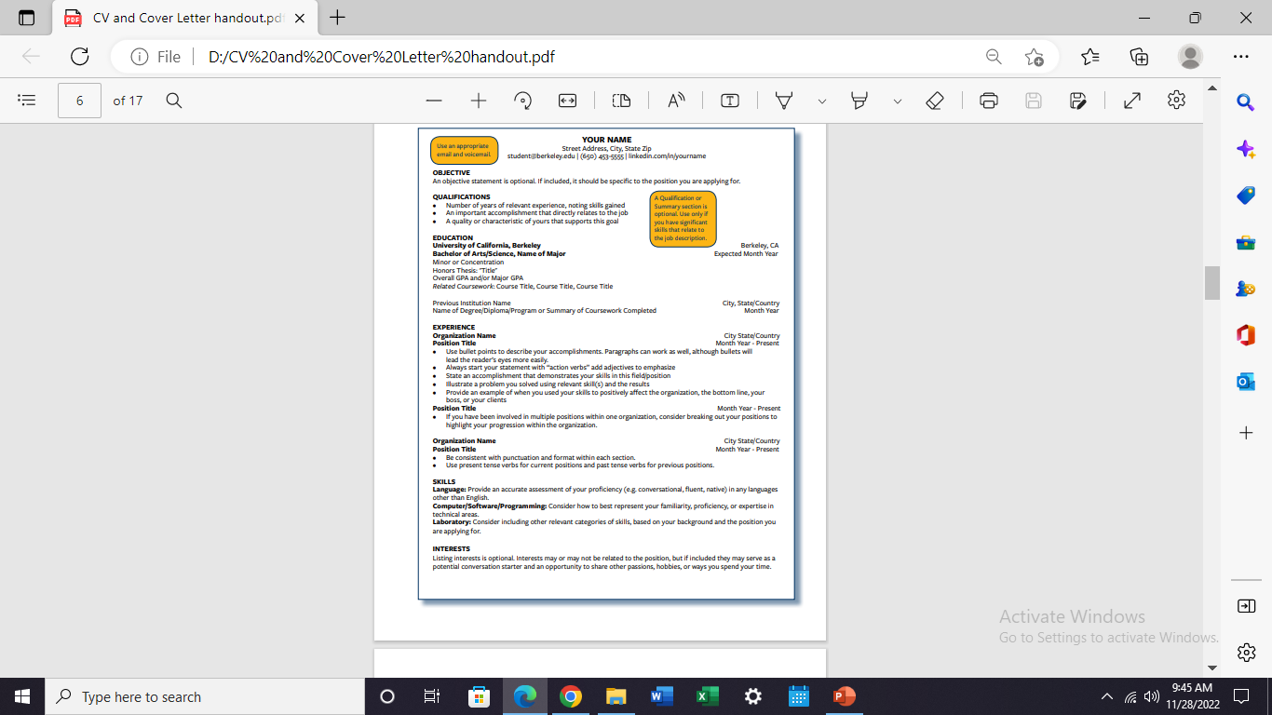

Slide 7
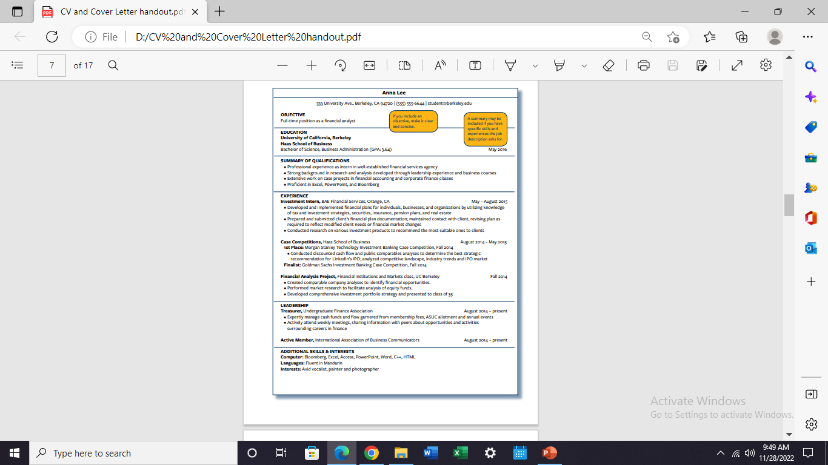

Slide 8
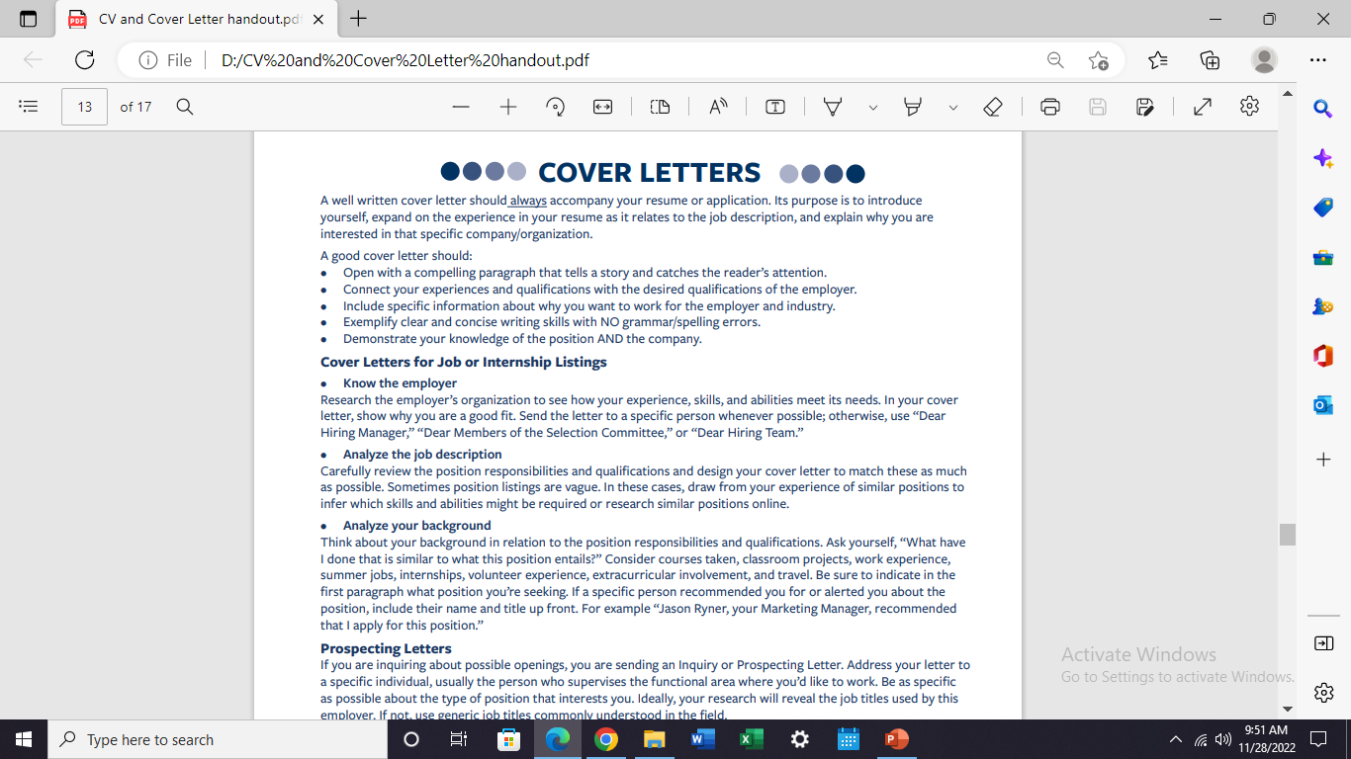

Slide 10
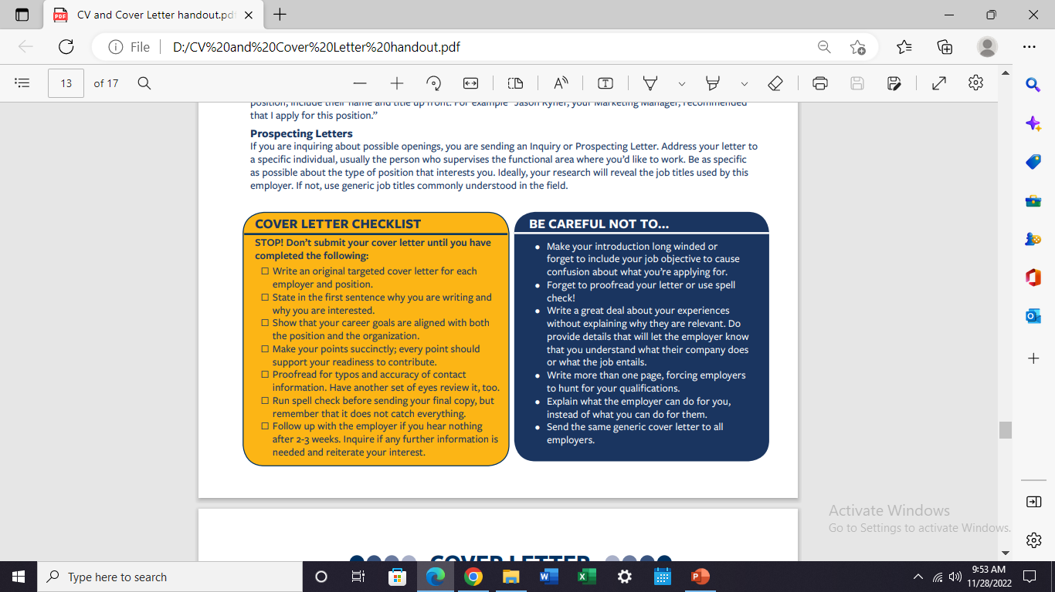

Slide 11
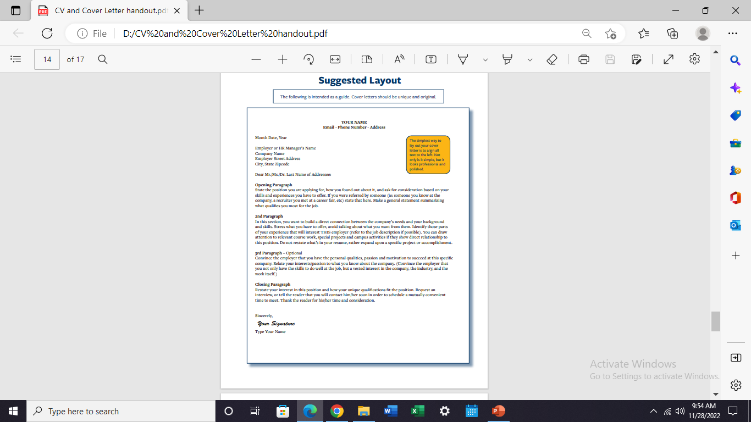

Slide 12
